Slide 1
Soudagum Hydro
April 2019

Slide 4
Soudagum Hydro
One-component, solvent-free, Hybrid Polymer waterproof coating
Waterproofing product for horizontal and vertical surfaces
Waterproof Hybrid membrane
Pack options:
134553 - 1KG Repair Kit
2 x 0.5kg foilpacks, 1 mixing box, 1 brush, 1 fleece (30x15cm) and a pair of protective gloves
131634 - 5KG Bucket – 5kg bag in bucket
131632 - 10KG Bucket – 2 x 5kg bags in bucket

Slide 5
Benefits
Ready to use, one component, no mixing
Low viscous product
Solvent-free
Isocyanate-free
Can be applied in 2 layers (1mm thickness/layer)
Water-vapor permeable – lets surfaces breathe

Slide 6
Features
Good temperature resistance (-40°C up to +80°C)
Rain resistant, 2 hours after application
Crack-bridging
Resistance to chemicals
UV and weathering resistance
Can be painted
Cures at room temperature
Short drying times (Ca. 3h / 1mm thickness)

Slide 7
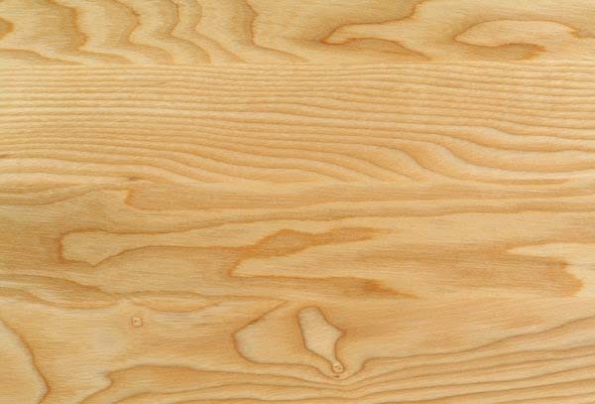
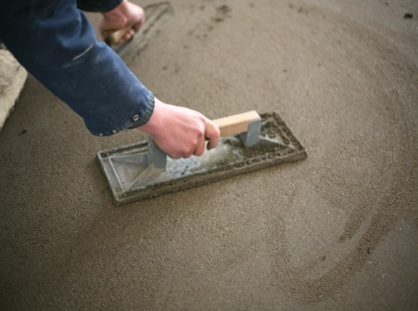
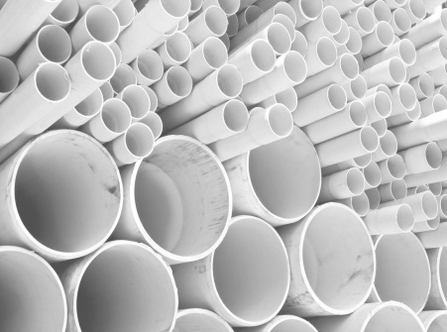
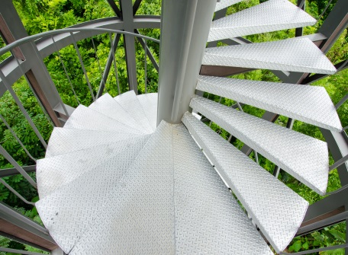
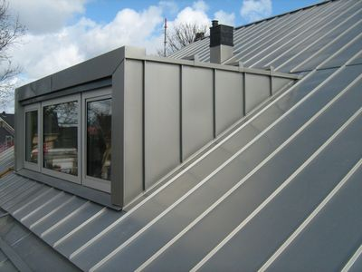
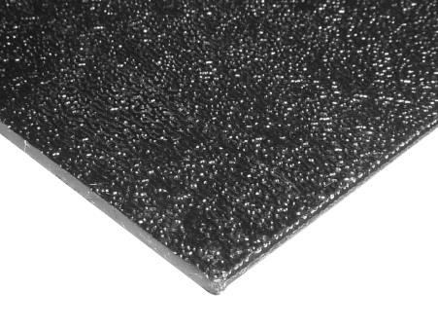
Substrates
Wood
Masonry
Screed
PVC
Metal
Aluminium
Glass
Zinc & Lead
ABS
Copper
Ceramics

Slide 8
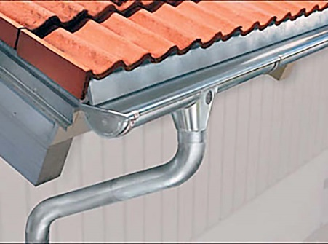
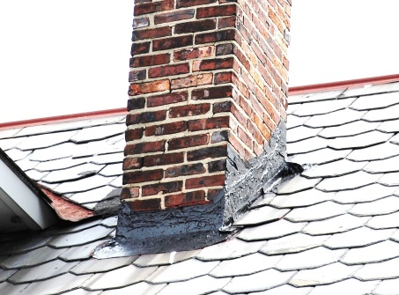
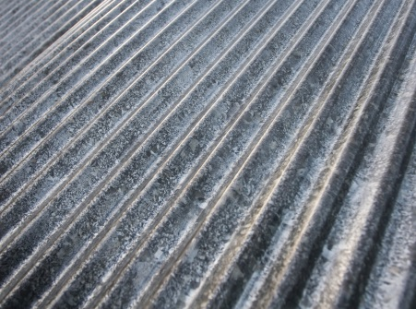
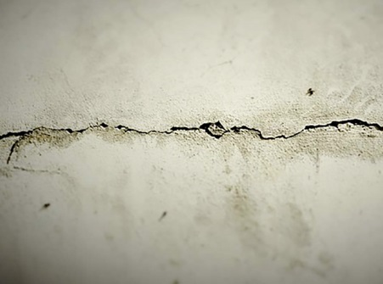
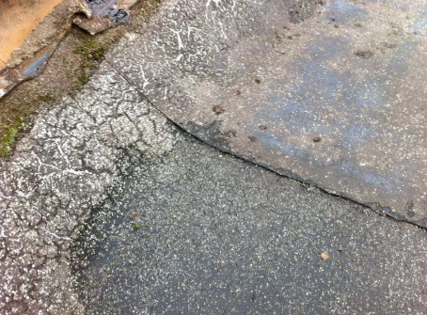
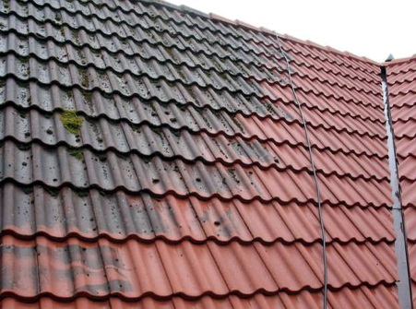
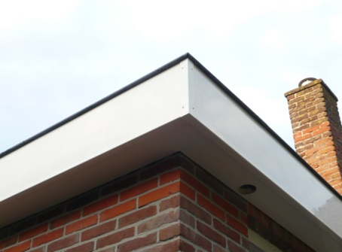
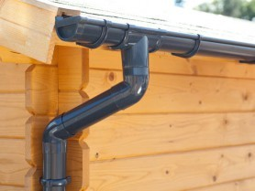
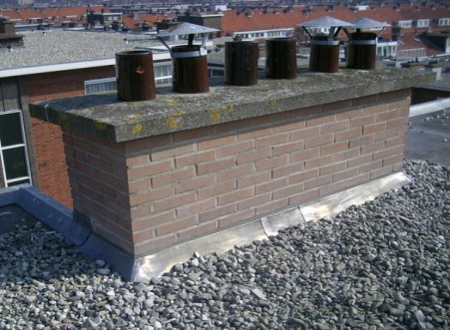
Applications
Repair metal & plastic roof gutters and drainage
Renovation & repair chimney, rooftops…
Sealing & repair concrete foundations, cellars and masonry
Treatment lead and zinc corrosion

Slide 9
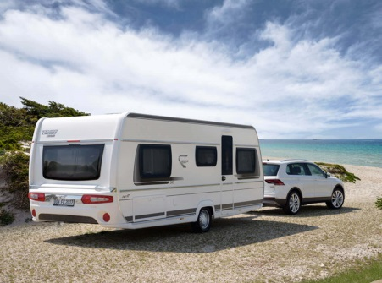
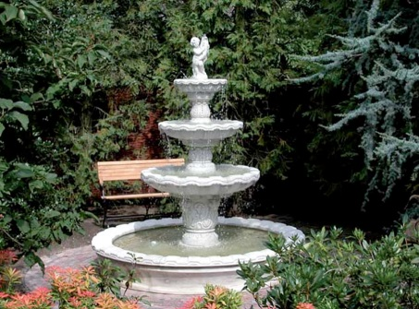
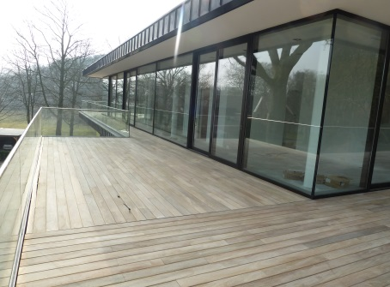
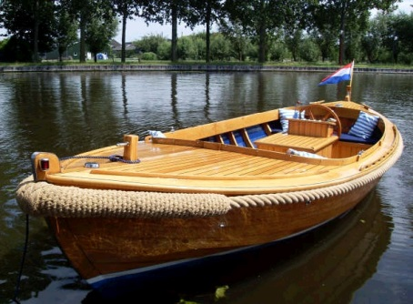
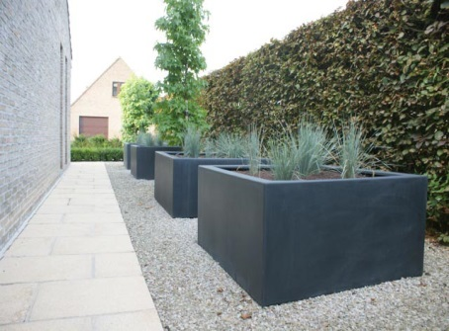
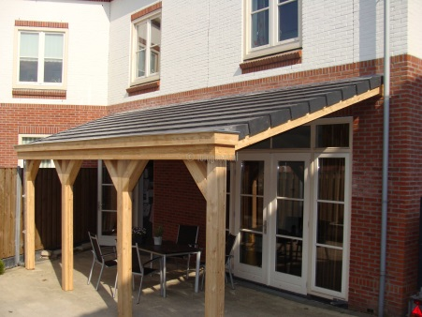
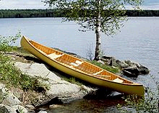
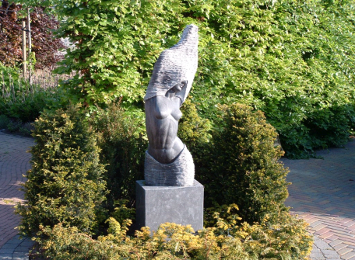
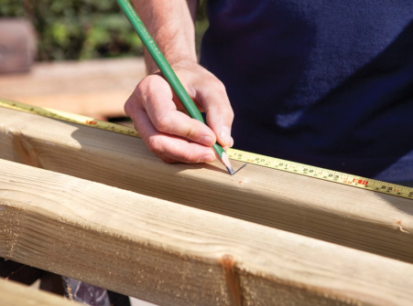
Applications
Ornaments, fountains, flower boxes…
Renovation & repair of boats, caravans…
Renovation & protection of wood constructions, terraces...
Garden poles

Slide 10
Guidelines
Step 1
Surfaces must be firm, load bearing and free of dust and grease. Remove all traces of loose existing coating material.
Step 2
Stir Soudagum Hydro in the container before using.
Step 3
Apply by roller or brush in 2 coats to a thickness of about 2mm when dry. The second coat cannot be applied until the first had dried completely.
The membrane can be reinforced with non-woven fleece. If so it’s recommended to be used between two coats (fleece quality: 110 g/m²). Fleece should buried in the first coat while it is still wet. The reinforcement overlaps must be between 3 and 5cm.
Usage: Ca. 1,4kg/m² (1mm) or Ca. 2,0kg/m² (2mm)

Slide 11
Tools & Cleaning material
During application:
Roller or Brush
Cleaning:
If not cured → use Soudal Surface Cleaner
If cured → can only be removed mechanically

Slide 12
POS - Materials
Movie
Water Module Display
TDS
Bucket labels
3-folded Flyer (NL / FR)
Sample Card (NL / FR)
Pylon (with side panel)
Pallet (with products)
Sales Leaflet (NL / FR)

Slide 13
Movie
MOVIE

Slide 14
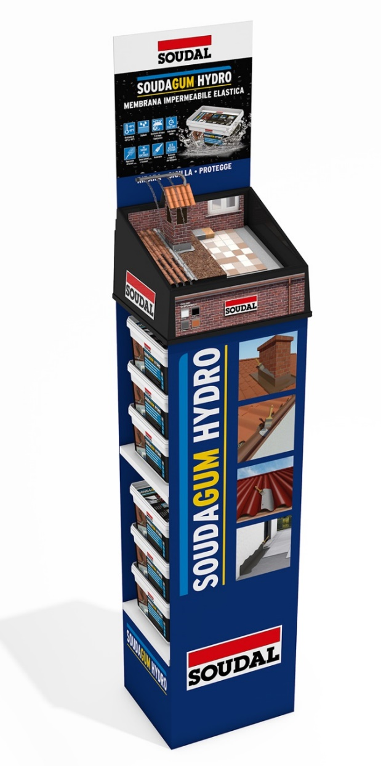
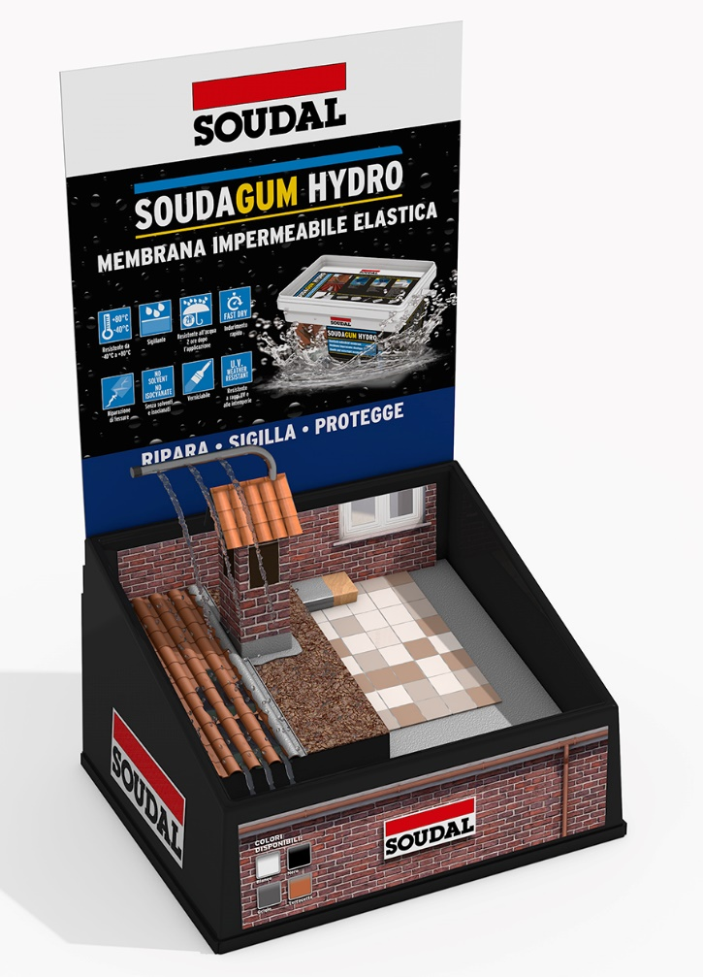
POS – Water Module Display

Slide 15
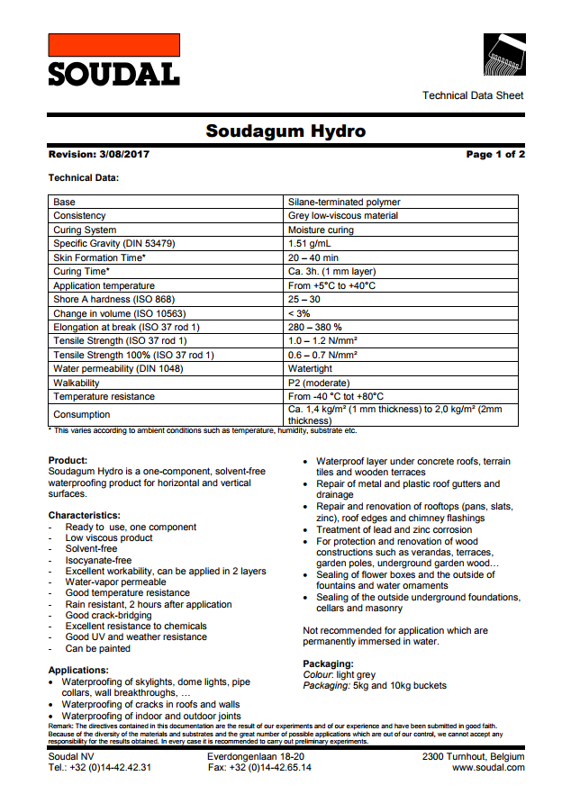
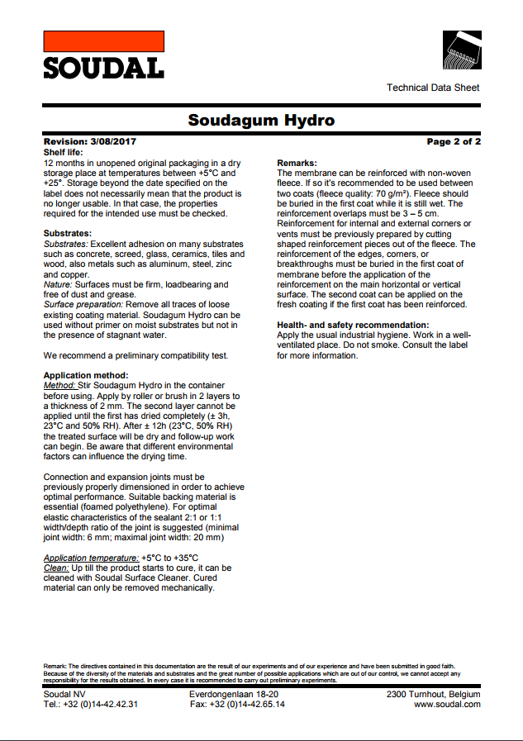
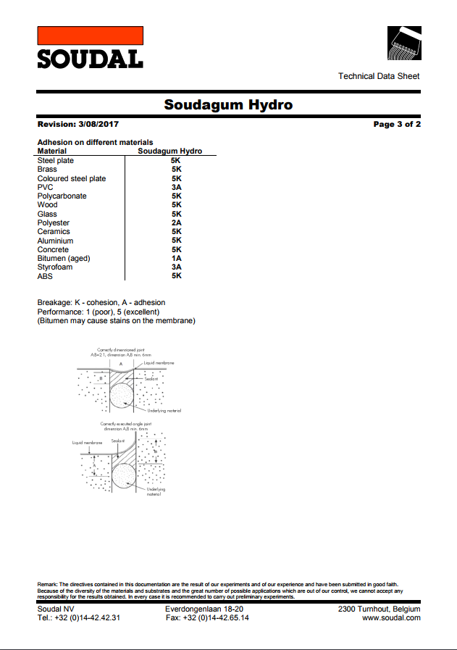
TDS

Slide 16
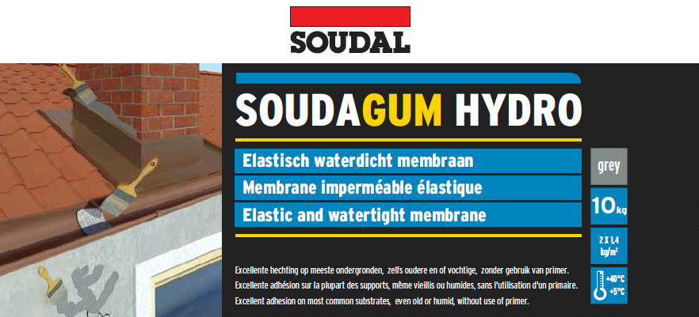
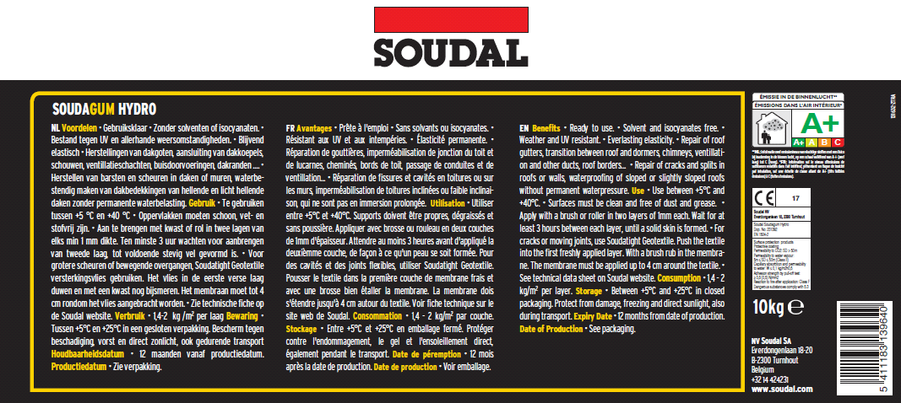
Bucket labels
10KG
(IFSP): 131631-LAB (DFE): 131632-LAB
5KG
(IFSP): 131633-LAB (DFE): 131634-LAB

Slide 17
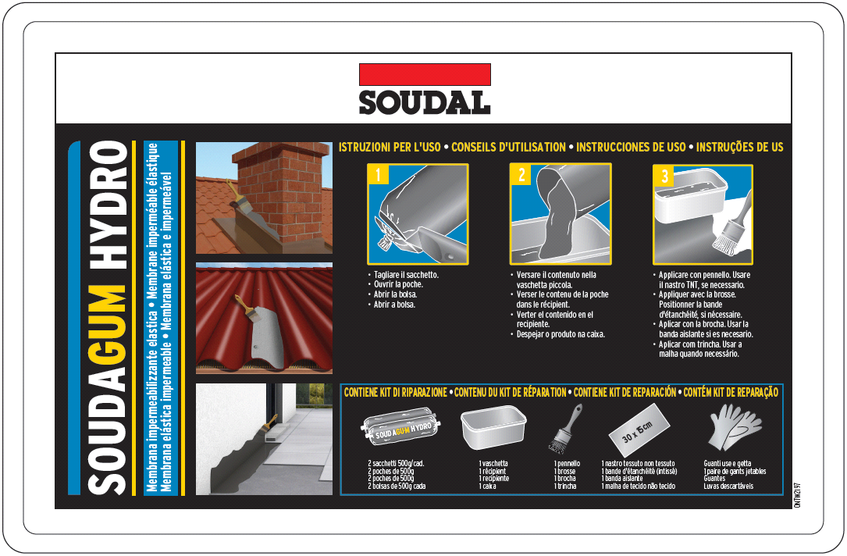
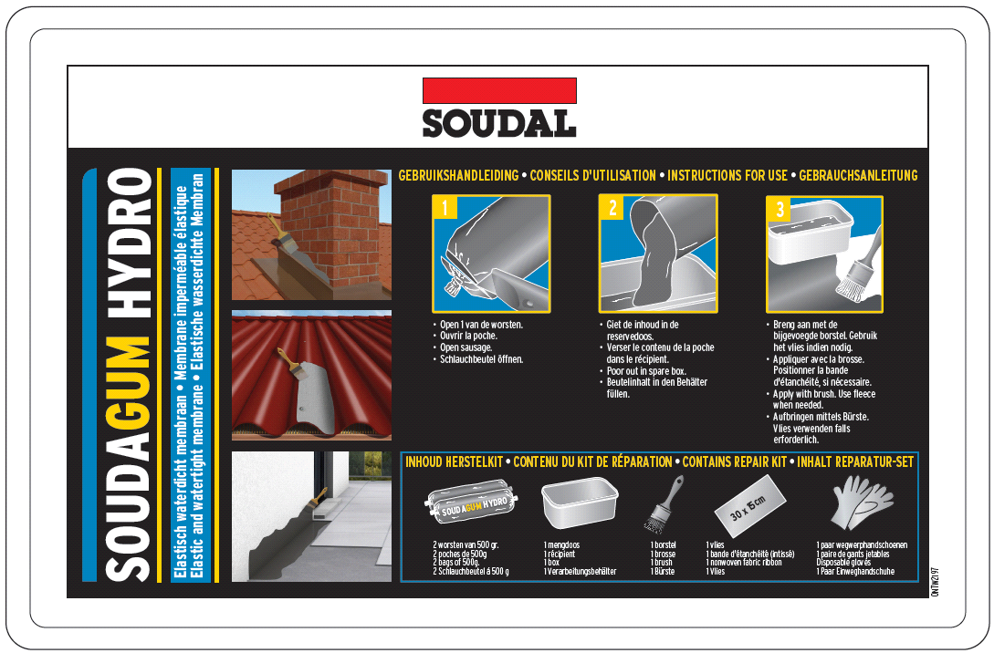
Bucket Labels: Top label
1KG
(IFSP): ONTW2197 IT_FR_SP_PT
(DFE): ONTW2197 NL_FR_EN_DE

Slide 18
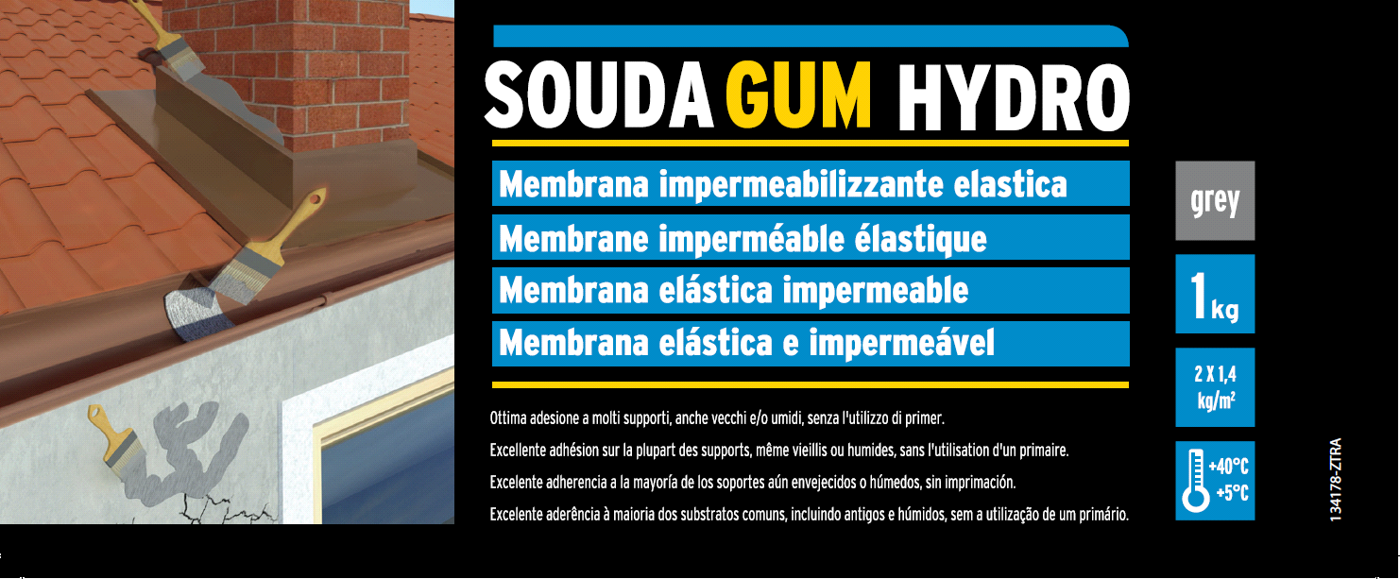
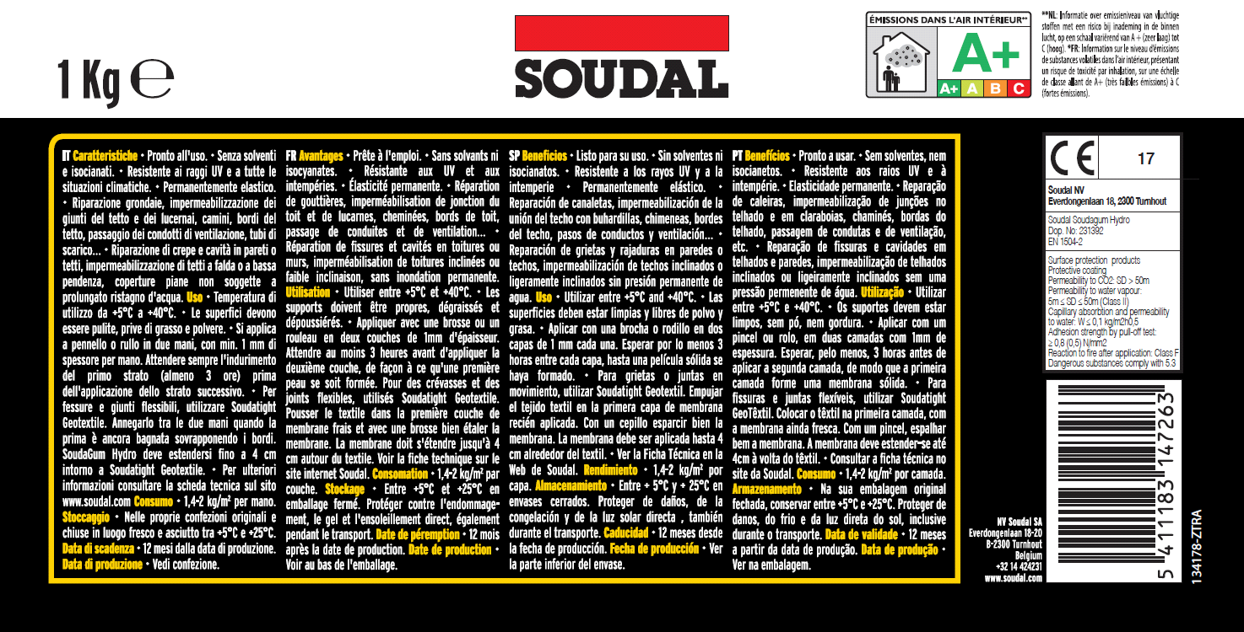
Bucket Labels: Label
Ref.:
ISPF: 134178 – ZTRA
DFE: 134553 –ZTRA

Slide 19
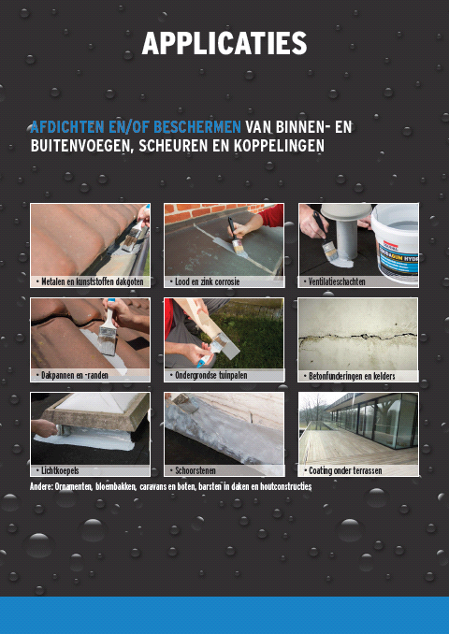
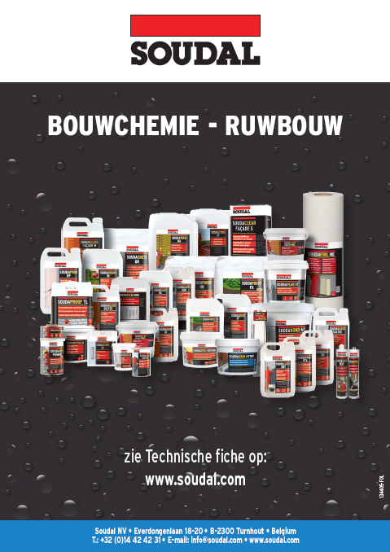
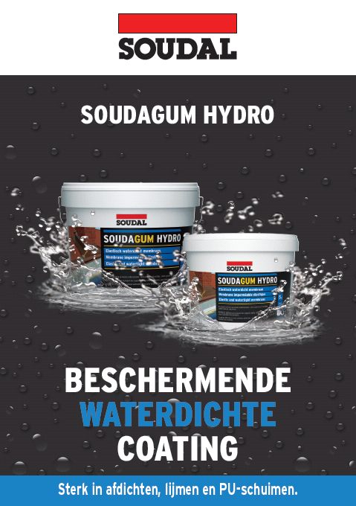
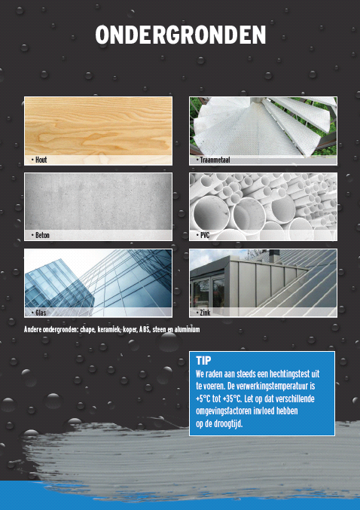
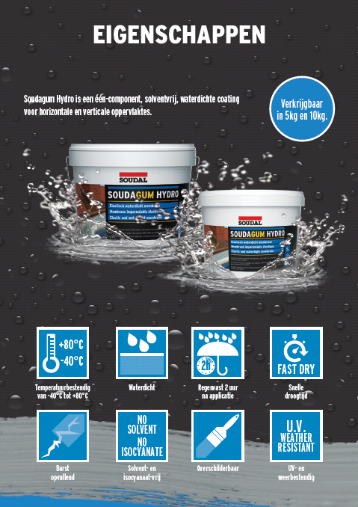
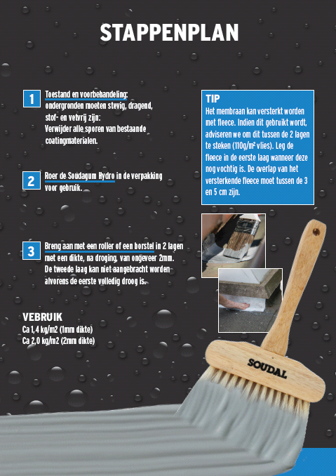
3-folded flyer (NL / FR)
Ref.
(NL): 134405-FOL
(FR): 134512-FOL
(EN): 134640-FOL

Slide 20
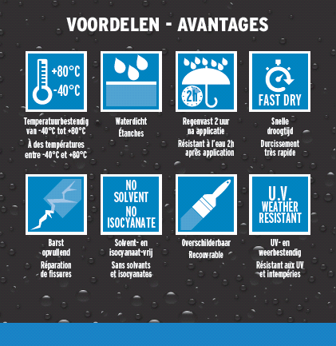
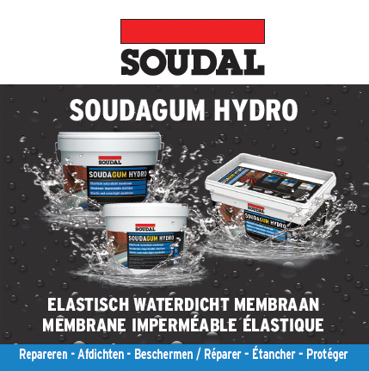
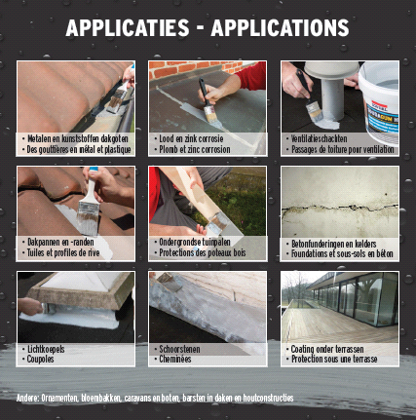
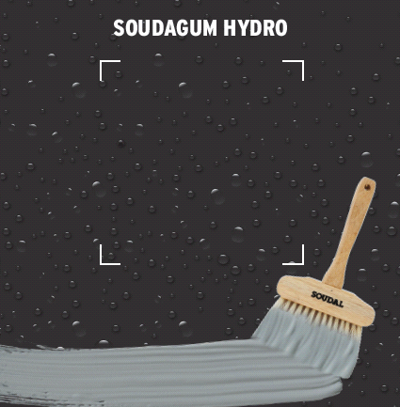
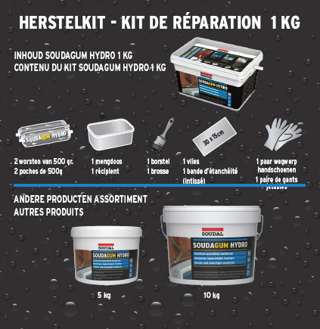
Sample Card (NL / FR)
Ref.
(NL / FR): 134541-FOL

Slide 21
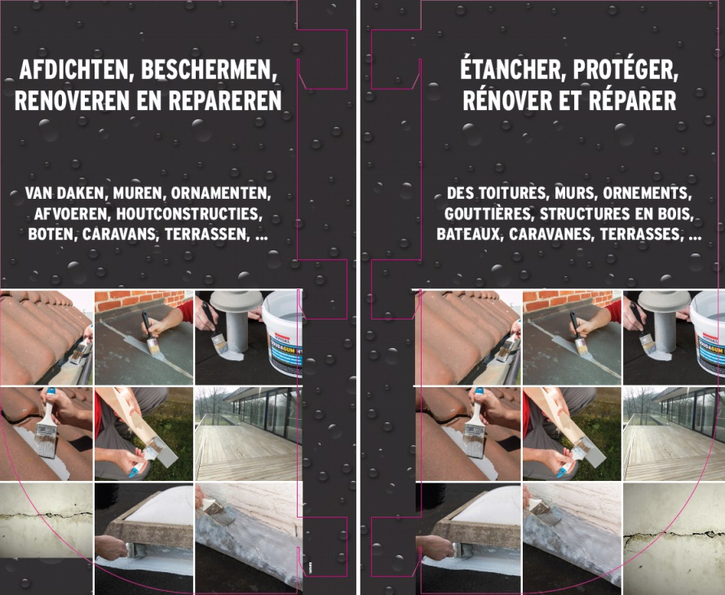
Pylon (with side panel)
Ref.
(NL / FR): 134510-OTH

Slide 22
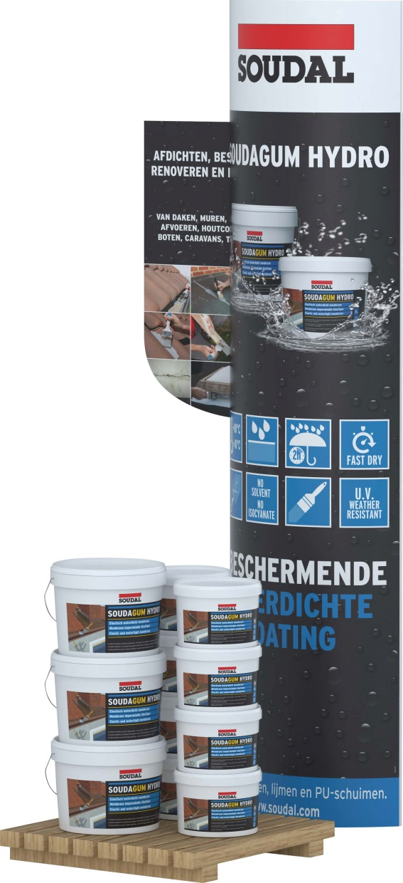
Pallet package (40cm x 60cm)
Included:
Pallet (40x60)
3x 10KG
8x 5KG
1x Pylon + Sidebanner
50x Brochure NL
50x Brochure FR
Ref.:
134554 - OTH

Slide 23
Sales Leaflet (NL / FR)

